Slide 1




NegotiaToR: Towards A Simple Yet Effective
On-demand Reconfigurable Datacenter Network
Cong Liang¹, Xiangli Song¹, Jing Cheng¹, Mowei Wang², Yashe Liu², Zhenhua Liu², Shizhen Zhao³, Yong Cui¹
¹Tsinghua University, ²Huawei Technologies Co., Ltd, ³Shanghai Jiao Tong University

Slide 2
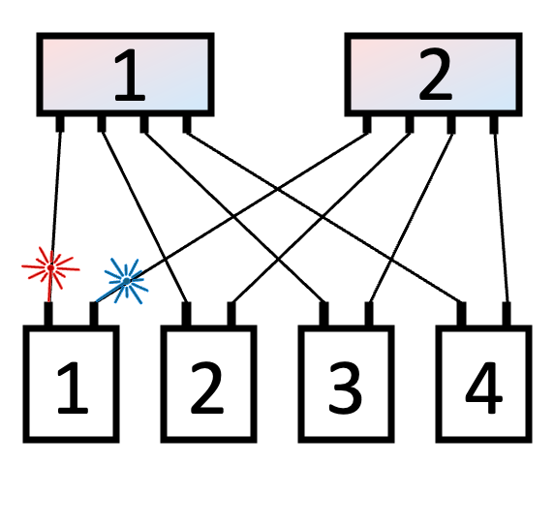
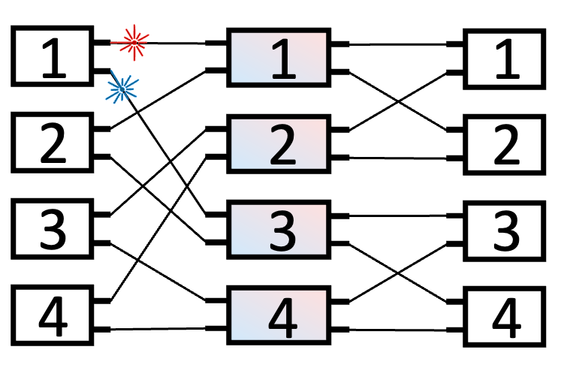
Background: Optical switching in DCN
Electrical packet switching: Capacity limitation in the post Moore’s Law era
Optical switching: High capacity & Low cost
  Recent advance of AWGR-based switching hardware
    Low end-to-end reconfiguration delay: Within 10 ns^{[1]}
    DCN scalability: Using flat topologies above ToRs
[1] Ballani et al., SIGCOMM ’20
Sufficient for fast reaction to dynamic traffic patterns among ToRs
src ToR
AWGR
dst ToR
AWGR
  But how to schedule the fast-reconfigurable optical links?
ToR
  Parallel network topology
  (High port-count AWGRs)
  Thin-clos topology
  (Low port-count AWGRs)

Slide 3
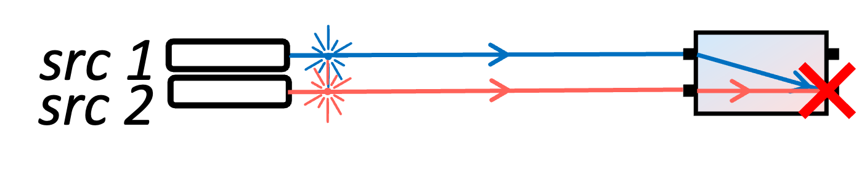
Scheduling the fast-reconfigurable optical links among ToRs
Goal: Rapidly getting non-conflicting paths
Traffic-oblivious: Predefined uniform round-robin & Data relay (e.g., Sirius^{[1]})
  Practical scheduler-less design
  Topology & traffic mismatch: Sacrificed latency and goodput
On-demand: Adapting topology to real-time traffic demands
  Potentially better performance
  Practicality concerns: Fast on-demand distributed scheduling?
[1] Ballani et al., SIGCOMM ’20
  Practical yet high performance on-demand distributed scheduling?

Slide 4
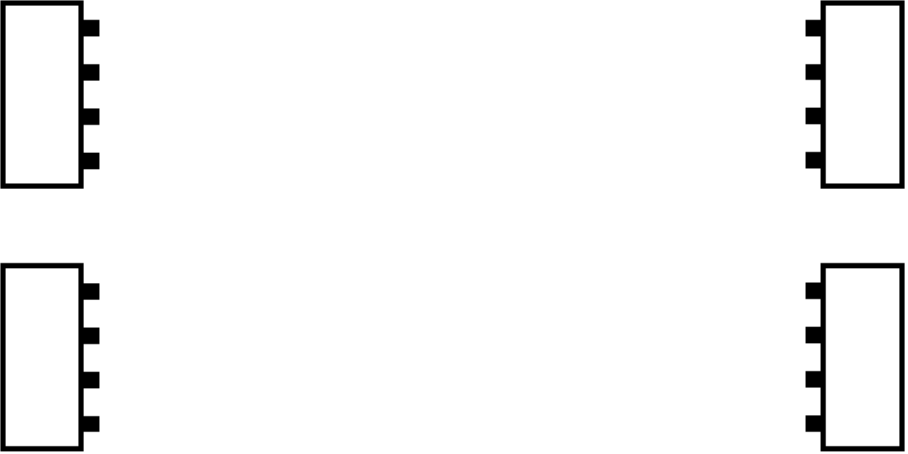
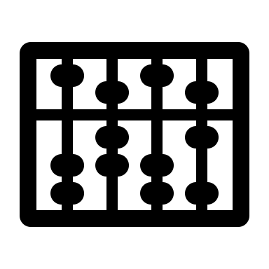

Challenges: On-demand distributed scheduling of
fast-reconfigurable optical links among ToRs
Src
ToR
Dst
ToR
flow to A @ t1, size U
flow to B @ t2, size V
flow to C @ t3, size W
flow from D @ t4, size X
flow from E @ t5, size Y
flow from F @ t6, size Z
dynamic demands among ToRs
Y > Z > X
…
…
t6 > t5 > t4
measurement
calculation
Demand measurement + Fast calculation at DCN scale?
  Challenge 1: High implementation complexity

Slide 5
Challenges: On-demand distributed scheduling of
fast-reconfigurable optical links among ToRs
Src
ToR
Dst
ToR
dynamic demands
decisions
Demand measurement + Fast calculation at DCN scale?
  Challenge 1: High implementation complexity
Separate network for scheduling messages?
  Challenge 2: Expensive to build and maintain a separate control plane

Slide 6



Challenges: On-demand distributed scheduling of
fast-reconfigurable optical links among ToRs
Src
ToR
Dst
ToR
dynamic demands
decisions
Demand measurement + Fast calculation at DCN scale?
  Challenge 1: High implementation complexity
Separate network for scheduling messages?
  Challenge 2: Expensive to build and maintain a separate control plane
Scheduling delay vs. Mice flows / Incasts?
  Challenge 3: Downgraded latency due to scheduling delay

Slide 7
NegotiaToR overview
An on-demand reconfigurable DCN architecture towards a simple yet effective design
Challenge 1
High implementation complexity
NegotiaToR Matching algorithm
Towards minimalist on-demand scheduling on flat topologies
Challenge 2
Expensive to build and maintain
a separate control plane
Two-phase epoch
In-band pipelined scheduling & One-hop direct transmission
Challenge 3
Downgraded latency
due to scheduling delay
Scheduling delay bypassing
FCT optimization for latency-sensitive flows

Slide 8
Scheduling optical links among ToRs on flat topologies
Conflicts at ports:
Flat topology
Many-to-one
One-to-many
[1] Anderson et al., ToCS ’93
[2] McKeown, PhD Thesis, UC
Berkeley ’95
[3] McKeown et al., ToN ’99
A matching problem!
Similar problems exist in crossbar packet switches
  Non-conflicting input-output matches: PIM^{[1]}, RRM^{[2]}, iSLIP^{[3]}…
    Fast and practical
    Extensive implementation experience
input
output
input
output
NegotiaToR Matching (inspired by RRM^{[2]})

Slide 9
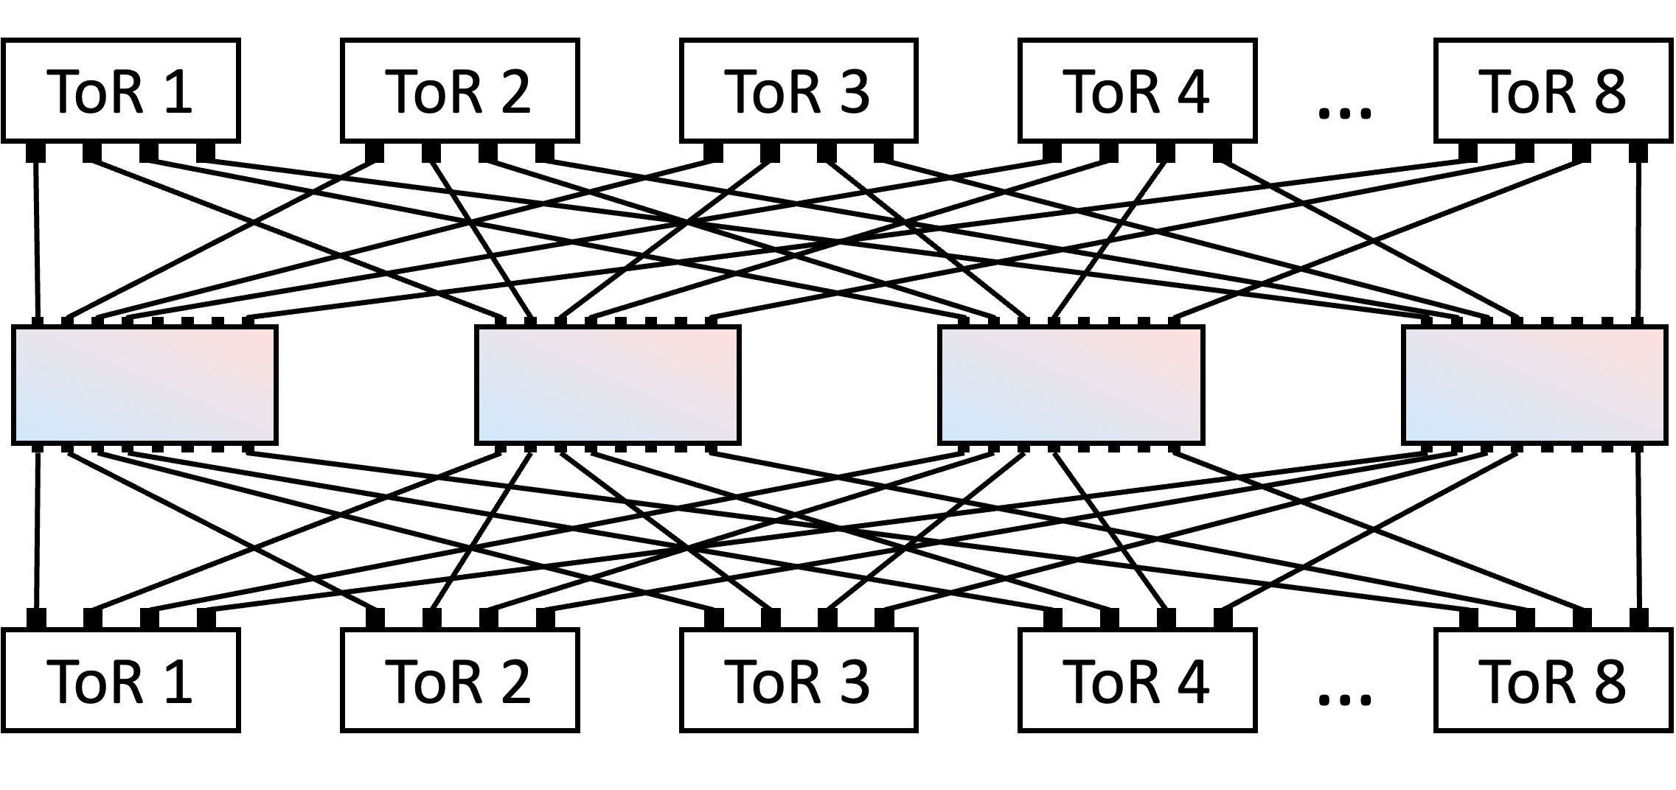
NegotiaToR Matching on flat topologies
Example on the parallel network topology:
Dst
AWGR
Src

Slide 10
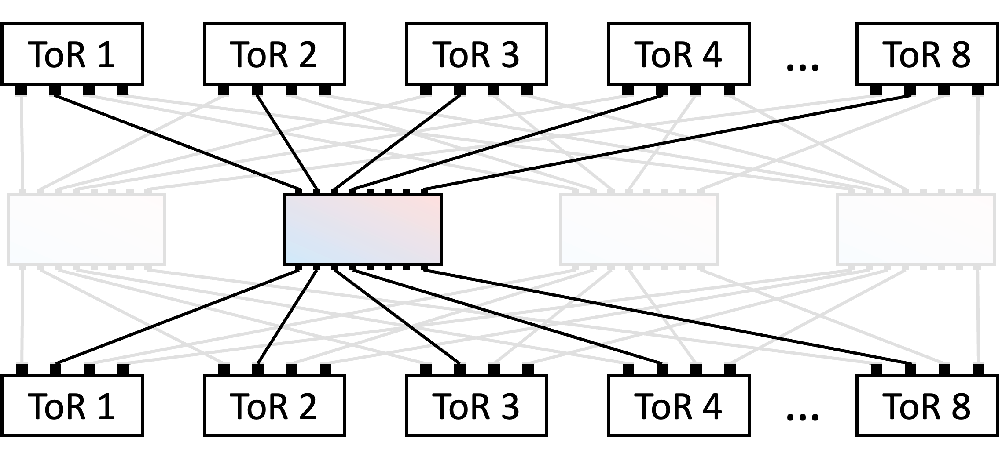
NegotiaToR Matching on flat topologies
Example on the parallel network topology:
Need to schedule multiple ports simultaneously
Each port can receive from all other ToRs
Dst
_
AWGR
Src
Traffic
demands
to ToR 2
to ToR 2, 4

Slide 11




NegotiaToR Matching on flat topologies
Example on the parallel network topology:
Traffic
demands
Src
Dst
to ToR 2
to ToR 2, 4

Slide 12
NegotiaToR Matching on flat topologies
Example on the parallel network topology:
ToR-level REQUEST
Traffic
demands
Src
Dst
Send binary requests to destinations
CONFLICT
to ToR 2
binary request
from ToR 1, 3
binary request
to ToR 2, 4
binary request
from ToR 3

Slide 13
NegotiaToR Matching on flat topologies
Example on the parallel network topology:
ToR-level REQUEST
Traffic
demands
Src
Dst
Send binary requests to destinations
8
1
CONFLICT
7
2
to ToR 2
1
3
6
3
Port-level GRANT
from ToR 1, 3
5
4
Eliminate many-to-one conflicts at destinations with RRM
ToR 2’s
GRANT ring
to ToR 2, 4
from ToR 3

Slide 14
NegotiaToR Matching on flat topologies
Example on the parallel network topology:
Ports share one ring for fairness
ToR-level REQUEST
Traffic
demands
Src
Dst
Send binary requests to destinations
8
1
1
for ToR 1
7
2
for ToR 3
6
3
to ToR 2
3
Port-level GRANT
for ToR 1
5
4
Eliminate many-to-one conflicts at destinations with RRM
for ToR 3
ToR 2’s
GRANT ring
to ToR 2, 4
from ToR 3

Slide 15
NegotiaToR Matching on flat topologies
Example on the parallel network topology:
Ports share one ring for fairness
ToR-level REQUEST
Traffic
demands
Src
Dst
Send binary requests to destinations
8
1
1
for ToR 1
7
2
for ToR 3
6
3
to ToR 2
3
Port-level GRANT
for ToR 1
5
4
Eliminate many-to-one conflicts at destinations with RRM
for ToR 3
ToR 2’s
GRANT ring
8
1
for ToR 3
1
7
2
to ToR 2, 4
for ToR 3
6
3
3
for ToR 3
3
5
4
for ToR 3
ToR 4’s
GRANT ring

Slide 16
NegotiaToR Matching on flat topologies
Example on the parallel network topology:
ToR-level REQUEST
Traffic
demands
Src
Dst
Send binary requests to destinations
for ToR 1
for ToR 1
for ToR 3
to ToR 2
for ToR 3
Port-level GRANT
for ToR 1
for ToR 1
for ToR 3
Eliminate many-to-one conflicts at destinations with RRM
for ToR 3
for ToR 3
for ToR 3
for ToR 3
to ToR 2, 4
for ToR 3
for ToR 3
for ToR 3
for ToR 3
for ToR 3

Slide 17
NegotiaToR Matching on flat topologies
Example on the parallel network topology:
ToR-level REQUEST
Traffic
demands
Src
Dst
Send binary requests to destinations
for ToR 1
to ToR 2
for ToR 1
to ToR 2
for ToR 3
Port-level GRANT
for ToR 1
to ToR 2
for ToR 1
Eliminate many-to-one conflicts at destinations with RRM
for ToR 3
for ToR 3
to ToR 4
for ToR 3
to ToR 2, 4
for ToR 3
for ToR 3
to ToR 2, 4
for ToR 3
to ToR 4
for ToR 3
for ToR 3
to ToR 2, 4
for ToR 3
for ToR 3
for ToR 3
CONFLICT

Slide 18
NegotiaToR Matching on flat topologies
Example on the parallel network topology:
ToR-level REQUEST
Traffic
demands
Src
per-port ACCEPT ring
Dst
Send binary requests to destinations
for ToR 1
to ToR 2
to ToR 2
for ToR 1
Port-level GRANT
to ToR 2
Eliminate many-to-one conflicts at destinations with RRM
for ToR 3
Port-level ACCEPT
to ToR 4
to ToR 2, 4
for ToR 3
to ToR 2, 4
for ToR 3
Eliminate one-to-many conflicts at sources with RRM
to ToR 4
for ToR 3
to ToR 2, 4
for ToR 3
for ToR 3

Slide 19
NegotiaToR Matching on flat topologies
Example on the parallel network topology:
ToR-level REQUEST
Traffic
demands
Src
per-port ACCEPT ring
Dst
Send binary requests to destinations
to ToR 2
✓
to ToR 2
Port-level GRANT
to ToR 2
✓
Eliminate many-to-one conflicts at destinations with RRM
✓
Port-level ACCEPT
to ToR 4
✓
to ToR 2, 4
to ToR 2, 4
Eliminate one-to-many conflicts at sources with RRM
✓
to ToR 4
✓
to ToR 2, 4

Slide 20

NegotiaToR Matching on flat topologies
Example on the parallel network topology:
ToR-level REQUEST
Traffic
demands
Src
Dst
Send binary requests to destinations
to ToR 2
Port-level GRANT
Eliminate many-to-one conflicts at destinations with RRM
Wavelength tuning according to locally derived scheduling results
Port-level ACCEPT
to ToR 2, 4
Eliminate one-to-many conflicts at sources with RRM

Slide 21
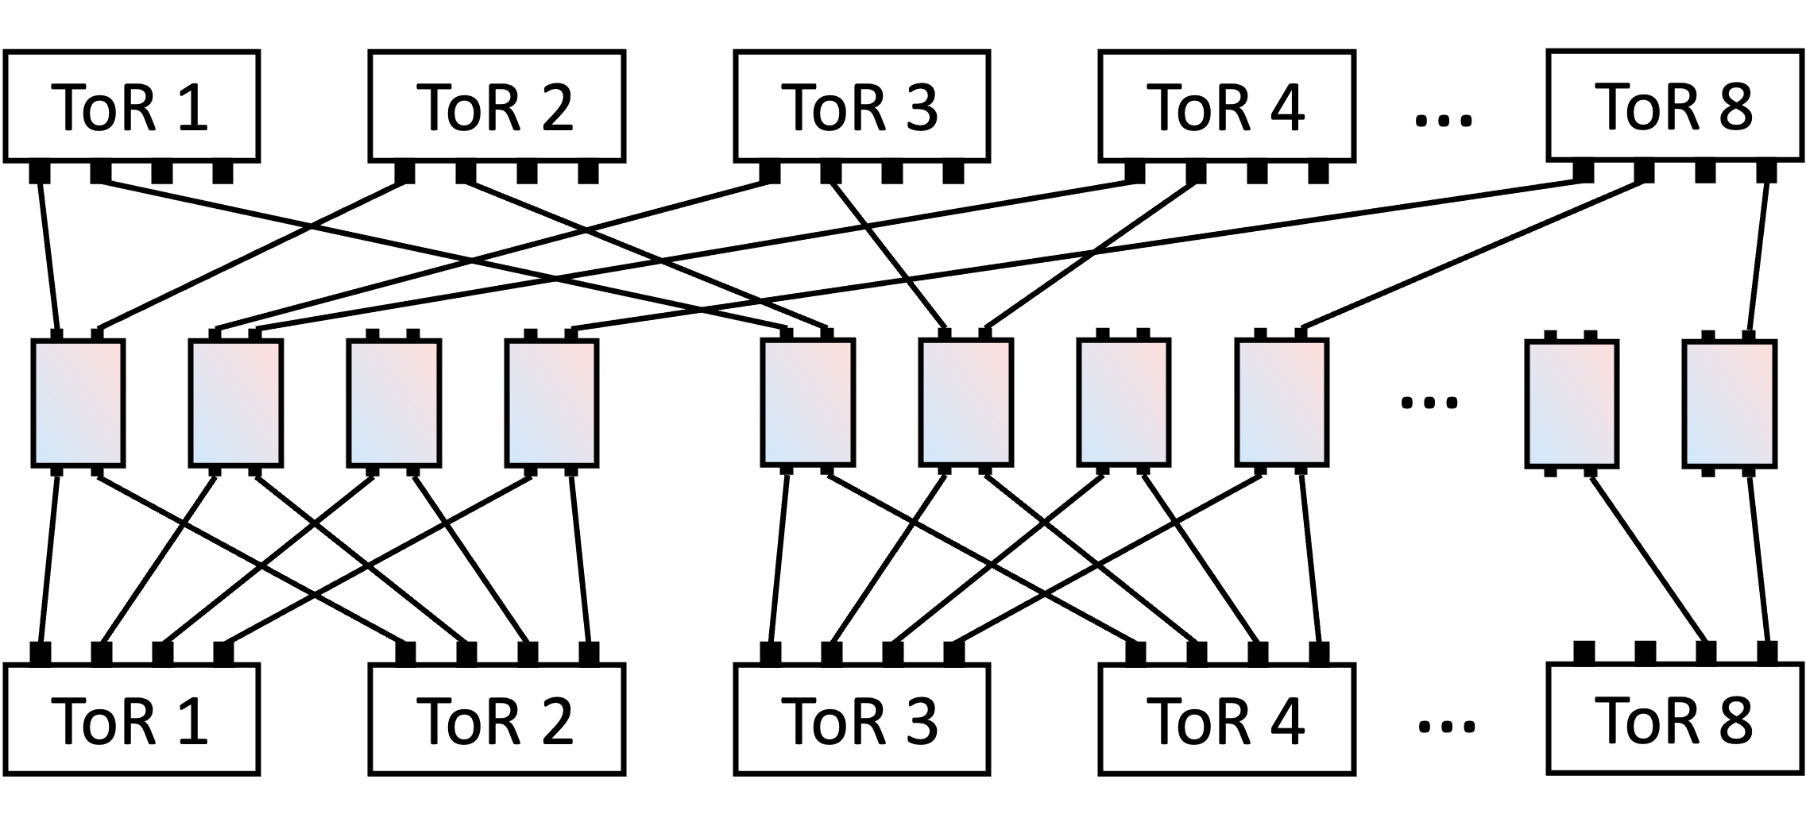
Adapting NegotiaToR Matching to topology capability
For topologies with limited connectivity…
  Example on the thin-clos topology with lower port-count AWGRs
Dst
AWGR
Src

Slide 22
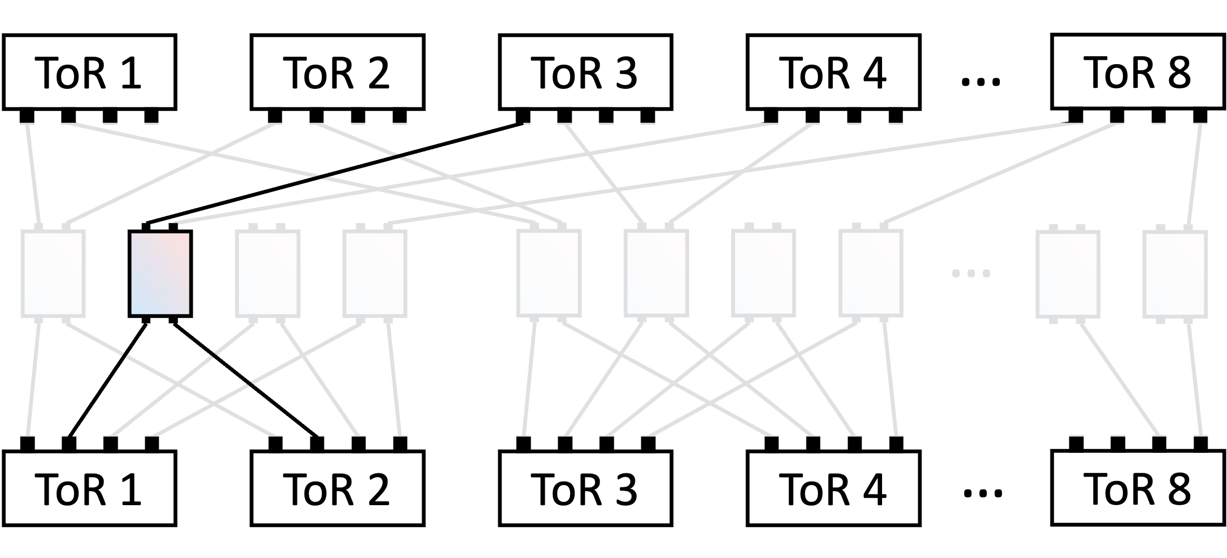
Adapting NegotiaToR Matching to topology capability
For topologies with limited connectivity…
  Example on the thin-clos topology with lower port-count AWGRs
8
1
1
7
2
6
3
3
5
4
Each port can only receive from a subset of ToRs
Dst
2
1
4
3
6
5
8
7
AWGR
per-port GRANT rings
Modify the rings to match the topology’s capability
Src

Slide 23
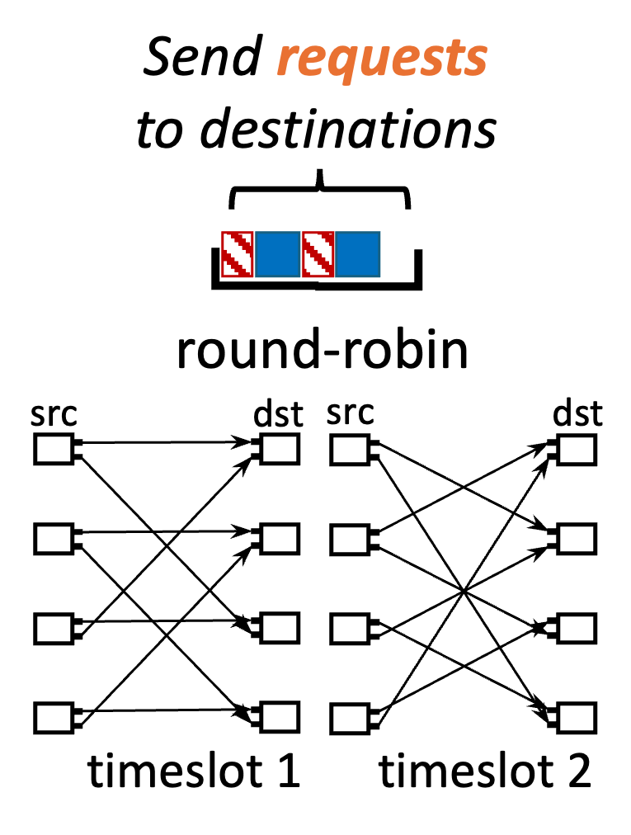
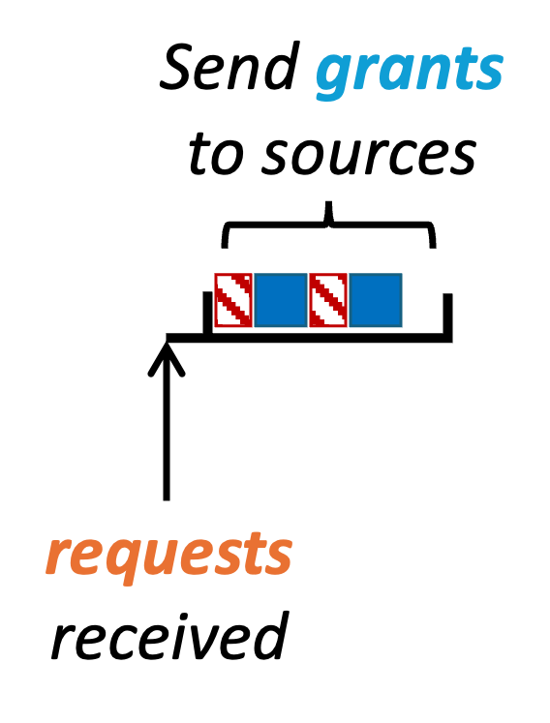
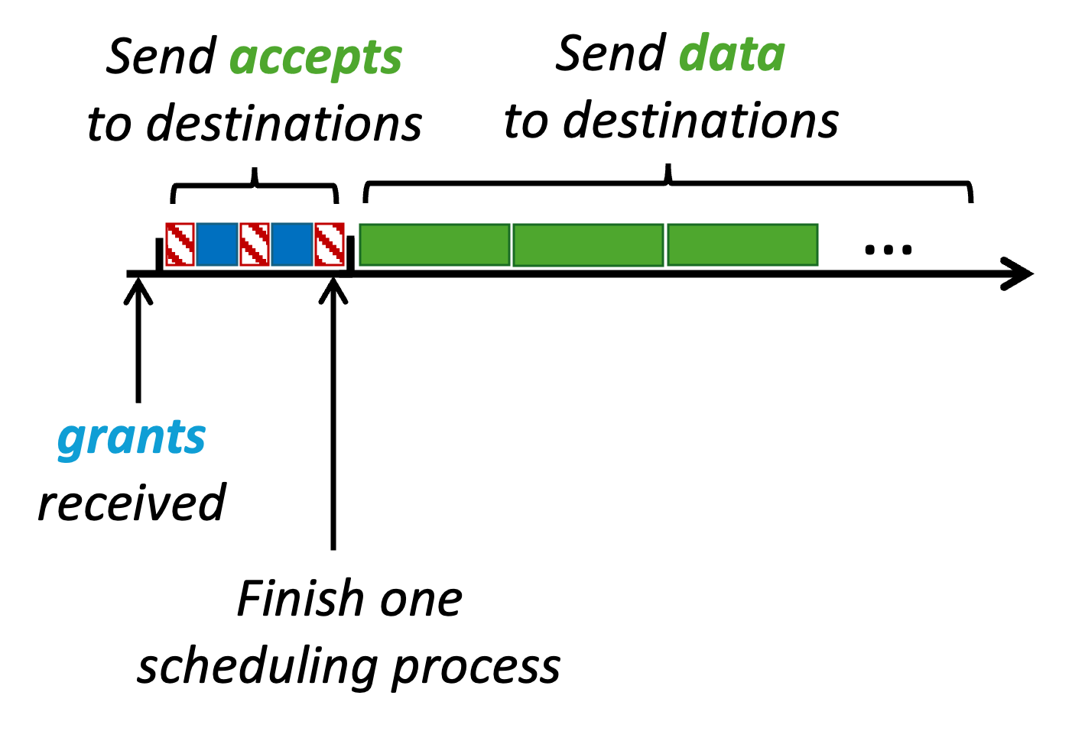

Supporting frequent exchanges of scheduling messages
ToR-level REQUEST
Port-level GRANT
Port-level ACCEPT
Requires full-mesh connectivity among all ToRs
Following previous practices^{[1][2][3]}
  Round-robin reconfiguration to work as full-mesh
[1] Mellette et al., SIGCOMM ’17
[2] Shrivastav et al., NSDI ’19
[3] Ballani et al., SIGCOMM ’20
One-way delay ($\sim$μs) between ToRs (at least)
One-way delay ($\sim$μs) between ToRs (at least)
Intuitive
solution
time
reconfiguration delay
scheduling messages
Link waste due to long one-way delay
data

Slide 24

Pipelined scheduling through two-phase epochs
request_{n}
request_{n+1}
request_{n+2}
reconfiguration delay
grant_{n-1}
grant_{n}
grant_{n+1}
scheduling messages
accept_{n-2}
accept_{n-1}
accept_{n}
data
Pipelined scheduling: Run three scheduling processes simultaneously
  Get a set of accepts after each round-robin
  Reconfiguration and data transmission after accepts

Slide 25

Pipelined scheduling through two-phase epochs
One NegotiaToR Epoch (fixed time interval)
reconfiguration delay
scheduling messages
data
Predefined phase
Frequent reconfigurations
Predefined connections
Pipelined distributed scheduling
Scheduled phase
No reconfiguration during it
On-demand connections
Send data through direct paths

Slide 26
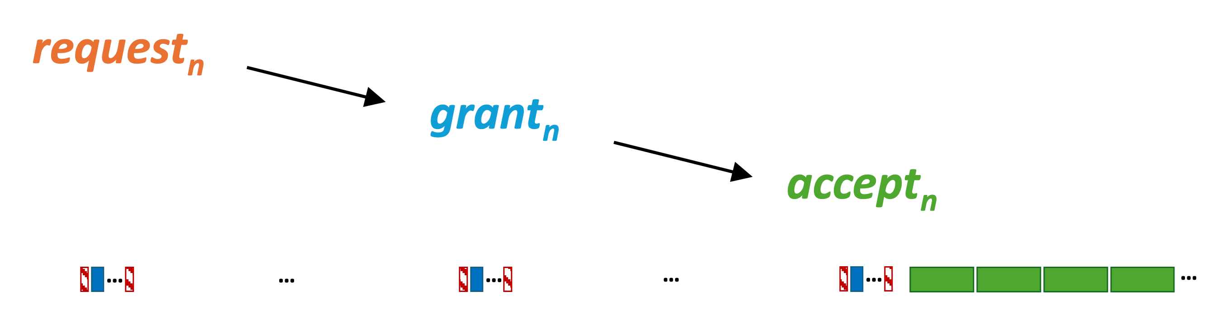
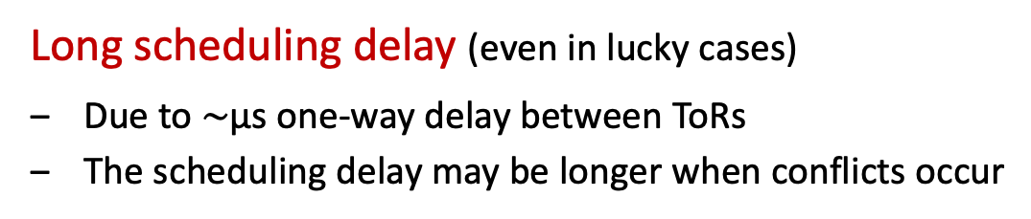

Latency vs. Scheduling delay
request_{n}
request_{n+1}
request_{n+2}
no traffic
grant_{n-1}
grant_{n}
grant_{n+1}
new traffic
reconfiguration delay
accept_{n-2}
accept_{n-1}
accept_{n}
scheduling messages
data
time
Epoch n
Epoch n+1
Epoch n+2
Long scheduling delay (even in lucky cases)
Due to $\sim$μs one-way delay between ToRs
The scheduling delay may be longer when conflicts occur
$\sim$2 epochs
Mice flows? Incasts?
Bypassing scheduling delay to optimize latency?

Slide 27
Scheduling delay bypassing for latency optimization
request_{n}
request_{n+1}
request_{n+2}
no traffic
grant_{n-1}
grant_{n}
grant_{n+1}
new traffic
reconfiguration delay
accept_{n-2}
Predefined phase:
Full-mesh connectivity
accept_{n-1}
accept_{n}
scheduling messages
data
time
Epoch n
Epoch n+1
Epoch n+2
Role of the predefined phase
Control plane: Exchanges of scheduling messages

Slide 28
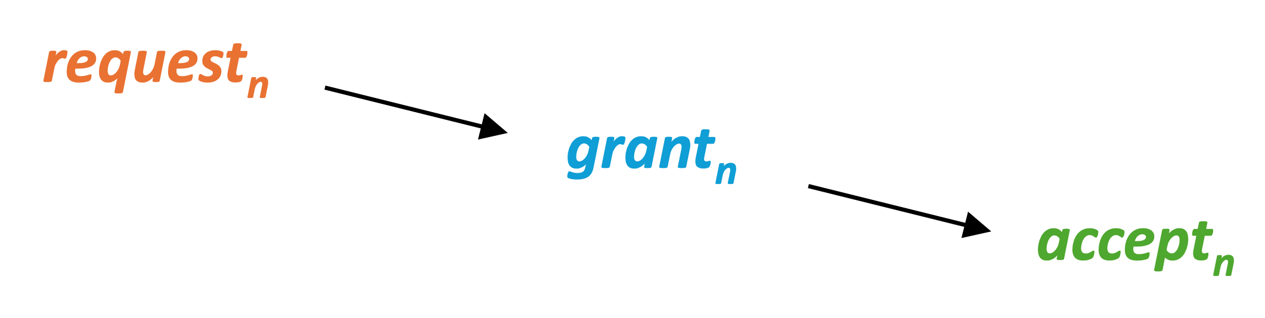
Scheduling delay bypassing for latency optimization
request_{n}
request_{n+1}
request_{n+2}
no traffic
grant_{n-1}
grant_{n}
grant_{n+1}
new traffic
reconfiguration delay
accept_{n-2}
Predefined phase:
Full-mesh connectivity
accept_{n-1}
accept_{n}
scheduling messages
data
time
Epoch n
Epoch n+1
Epoch n+2
Role of the predefined phase
Control plane: Exchanges of scheduling messages
Data plane: Also piggybacking small data packets
  Guaranteed unscheduled transmission
  Sufficient for mice flows (small in size), even under incasts

Slide 29
Scheduling delay bypassing for latency optimization
request_{n}
request_{n+1}
request_{n+2}
no traffic
grant_{n-1}
grant_{n}
grant_{n+1}
new traffic
reconfiguration delay
accept_{n-2}
Predefined phase:
Full-mesh connectivity
accept_{n-1}
accept_{n}
scheduling messages
data
time
Epoch n
Epoch n+1
Epoch n+2
Role of the predefined phase
Control plane: Exchanges of scheduling messages
Data plane: Also piggybacking small data packets
  Guaranteed unscheduled transmission
  Sufficient for mice flows (small in size), even under incasts
[1] Bai et al., NSDI ’15
  Maximize opportunities: Prioritize mice flows
    Information-agnostic mice flow prioritization like PIAS^{[1]}
HoL blocking by elephant flows?

Slide 30
NegotiaToR’s design efforts towards practicality
[1] McKeown, PhD Thesis, UC
Berkeley ’95
[2] Gupta et al., IEEE Micro ’99
Proven implementation strategies
  Inspired by RRM^{[1]}: Programmable priority encoders to implement rings^{[2]}
Simple designs
  No iteration
  No data relay
  Binary requests
  Stateless scheduling
Could a more complex design significantly improve NegotiaToR’s performance?

Slide 31
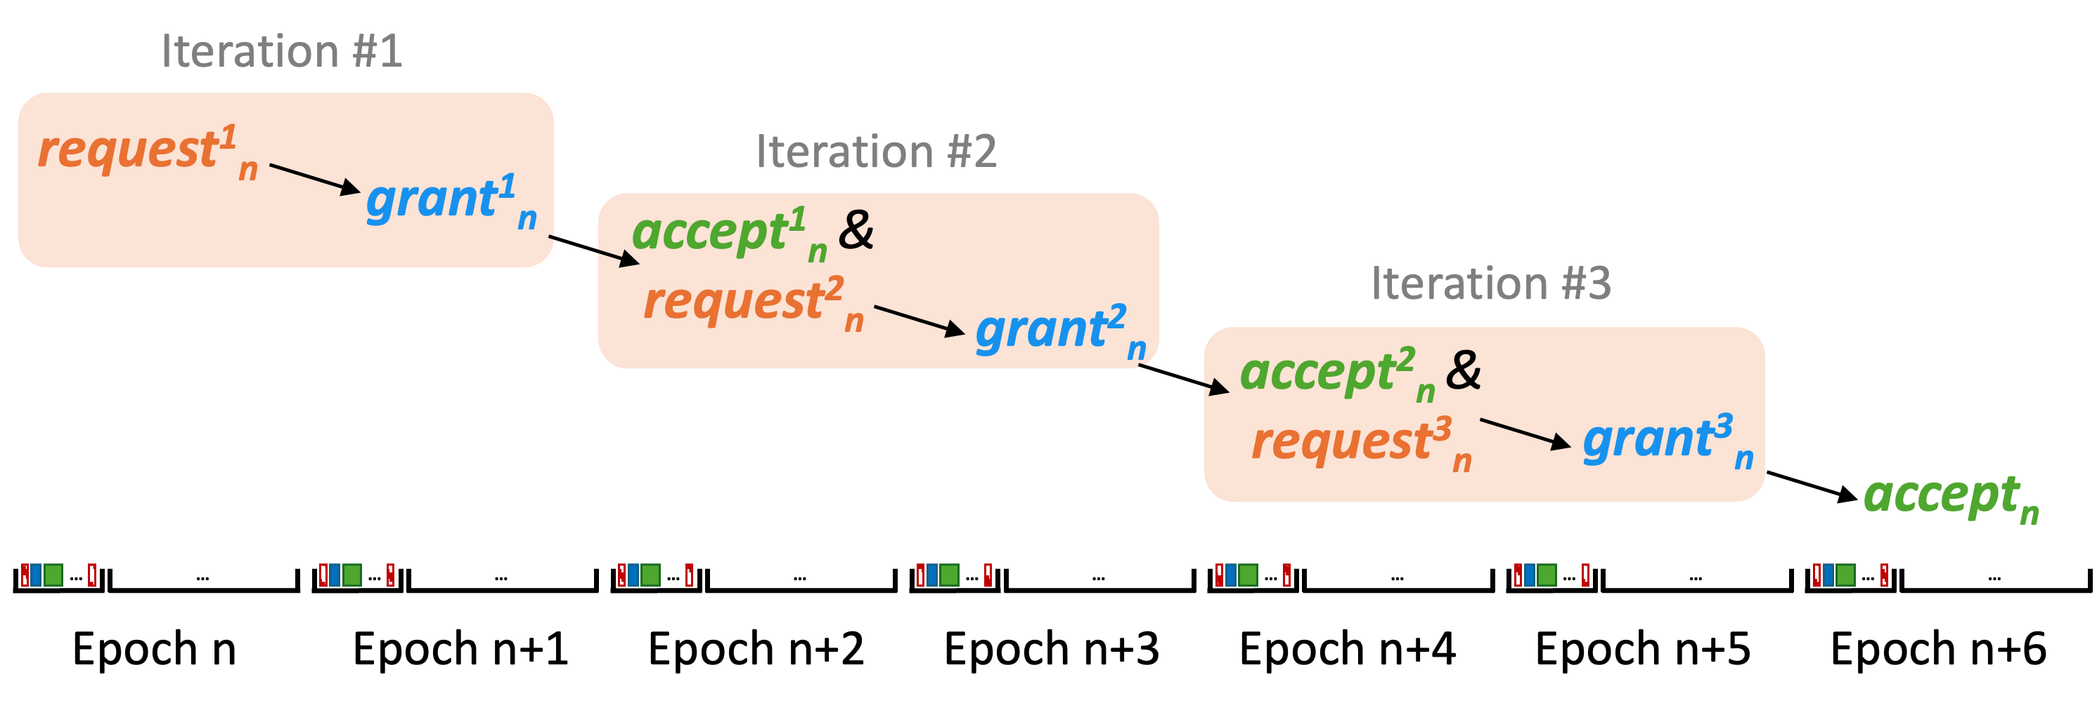
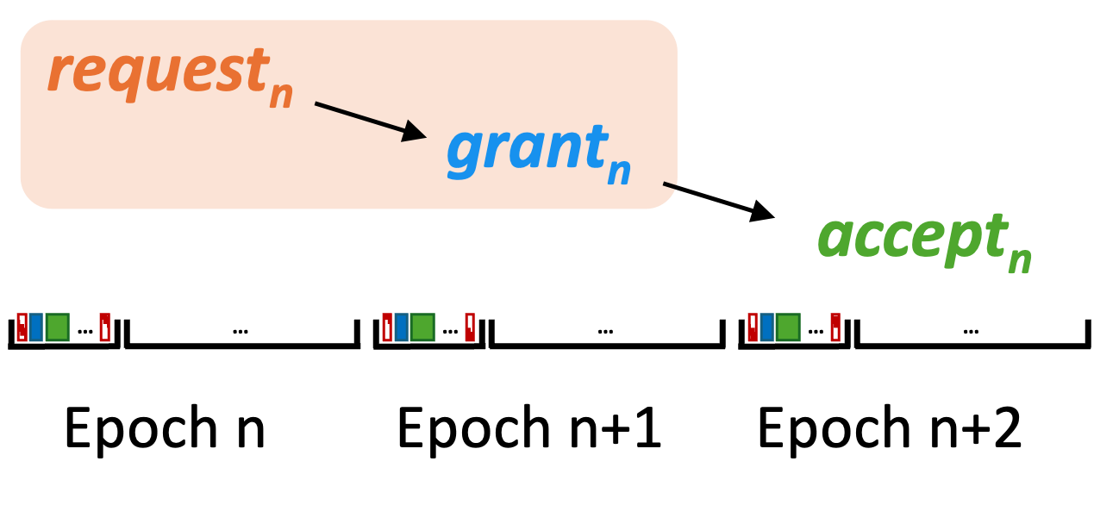
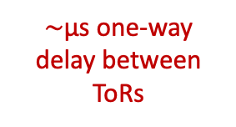
The rationality of NegotiaToR’s design choices
Example: Iterative scheduling?
  Following practices in crossbar switch port matching
  Difference: NegotiaToR has a longer delay between consecutive steps
data may already be sent…
3 iterations
No iteration
$\sim$μs one-way delay between ToRs
Scheduling delay: 6 epochs +
Scheduling delay: 2 epochs +
Possibly downgraded performance (Confirmed by experimental results)
Link waste
Outdated requests
Please refer to our paper for more explorations

Slide 32
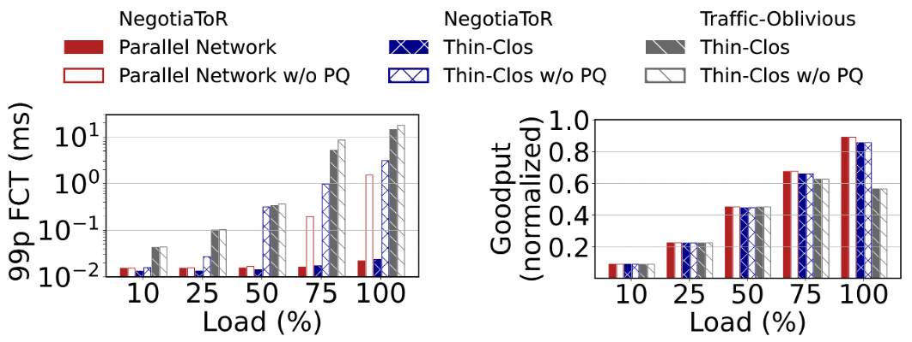
Evaluation
[1] Roy et al., SIGCOMM ’15
[2] Ballani et al., SIGCOMM ’20
Simulation setup: 128 ToRs, Hadoop trace^{[1]}
  Connected by 2 flat topologies
  10 ns reconfiguration delay
  2x speedup for both NegotiaToR
  and the traffic-oblivious scheme^{[2]}
  Consider ToRs as endpoints
  Results without mice flow
  prioritization are also shown
99th-percentile FCT of mice flows (<10KB)
Goodput
NegotiaToR achieves both small mice flow FCT and high goodput
on two representative flat topologies

Slide 33
NegotiaToR summary
An on-demand reconfigurable DCN architecture towards a simple yet effective design
NegotiaToR Matching algorithm
Towards minimalist on-demand scheduling
on flat topologies
Thank you!
Speaker: Cong Liang
liangxcong@outlook.com
Two-phase epoch
In-band pipelined scheduling &
One-hop direct transmission
Scheduling delay bypassing
FCT optimization for
latency-sensitive flows

